Slide 1
OPENPhysEd.org
Presented by:
OPEN Coach Name Here
Certified OPEN Community Curriculum Coach
@YourTwitterHandle @OPENPhysEd
Notes:
Introduce yourself quickly, Attend to the context of the day, (i.e., agenda, breaks, etc.), talk for 2 minutes about your CCC training experience. Ask people to tag you when Tweeting about the day. Remind them to follow @OPENPhysEd.

Slide 2
What is OPEN?
OPEN is the Online Physical Education Network. [OPENPhysEd.org]
It is a FREE open source curriculum project for physical educators and physical activity leaders.
OPEN is provided as a public service of US Games. A portion of every equipment purchase from US Games goes toward sustaining the OPEN curriculum project.
Notes:
Follow bullets, good to provide your expereince using resources from OPENPhysEd.org, Explain that each teacher can support the OPEN project by buying their equipment from US Games. Express how important it is to “vote” for equity of access with their dollars.

Slide 3
What is OPEN?
OPEN is backward-designed from the SHAPE America National Standards and Grade-Level Outcomes.
Current academic rigor strategies are infused throughout the curriculum modules.
Strategies include:
Academic Language Vocabulary Cards
Depth of Knowledge Tiered Debrief Questions
Teacher Reflection Guides (4 Domains of Teaching)
Notes:
Breifly talk about each bullet, let participants know that more informaiton about each of these topics can be found on the OPENPhysEd.org Blog.

Slide 4
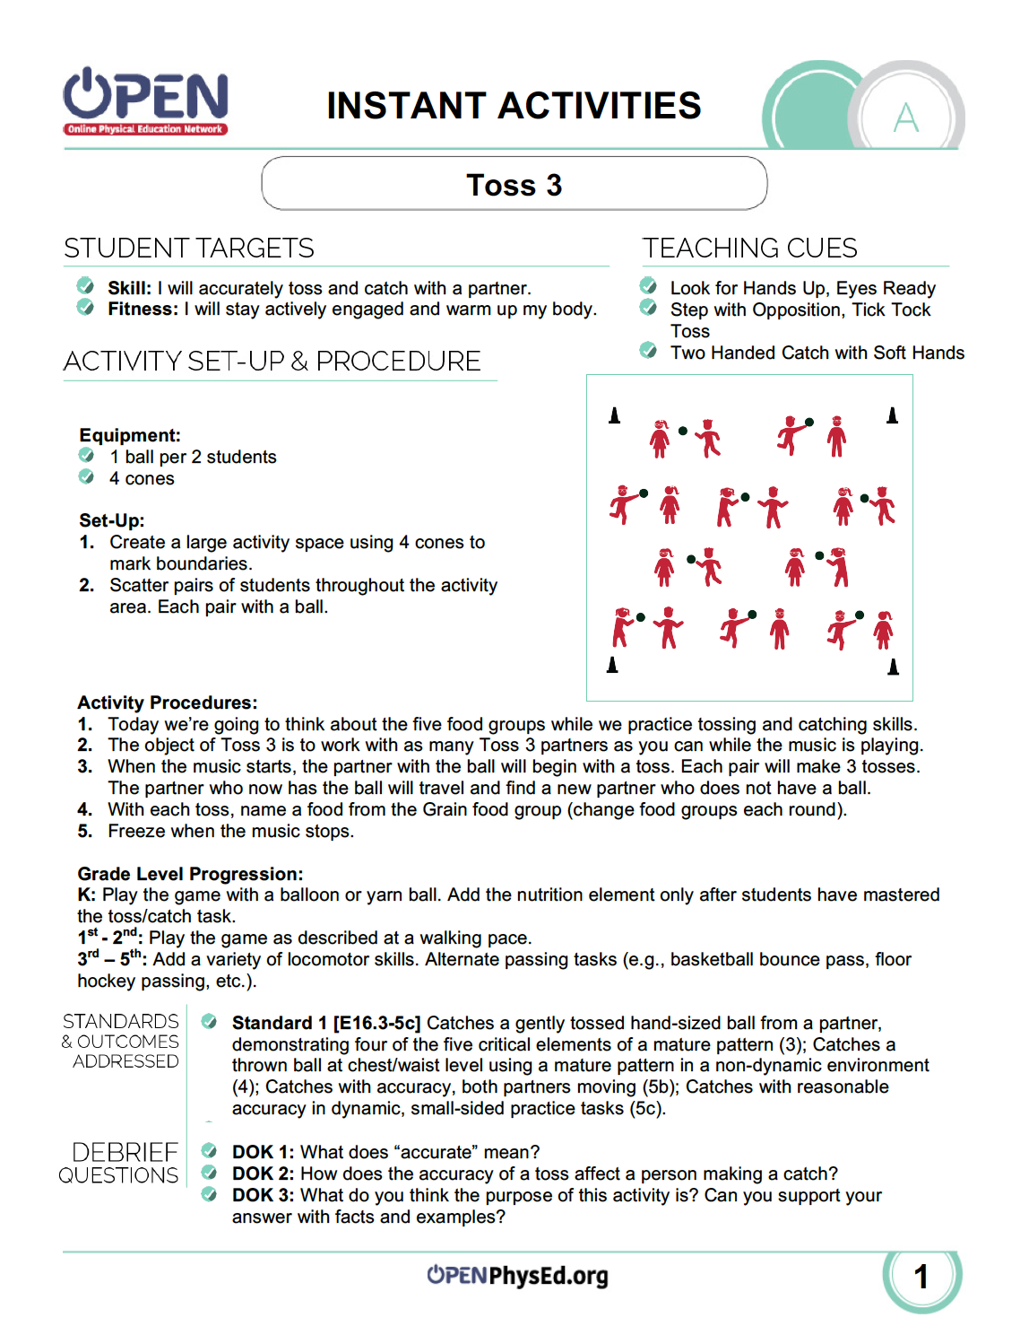
Let’s Experience OPEN’s Backward Design!
SHAPE America Standard 1, Outcome E16.4: Catches a thrown ball at chest/waist level using a mature pattern in a non-dynamic environment.
Toss 3 (K-5 & Secondary Instant Activities)
Notes:
Reference the Outcome very quickly, then get participants moving.
Play Toss 3.

Slide 5
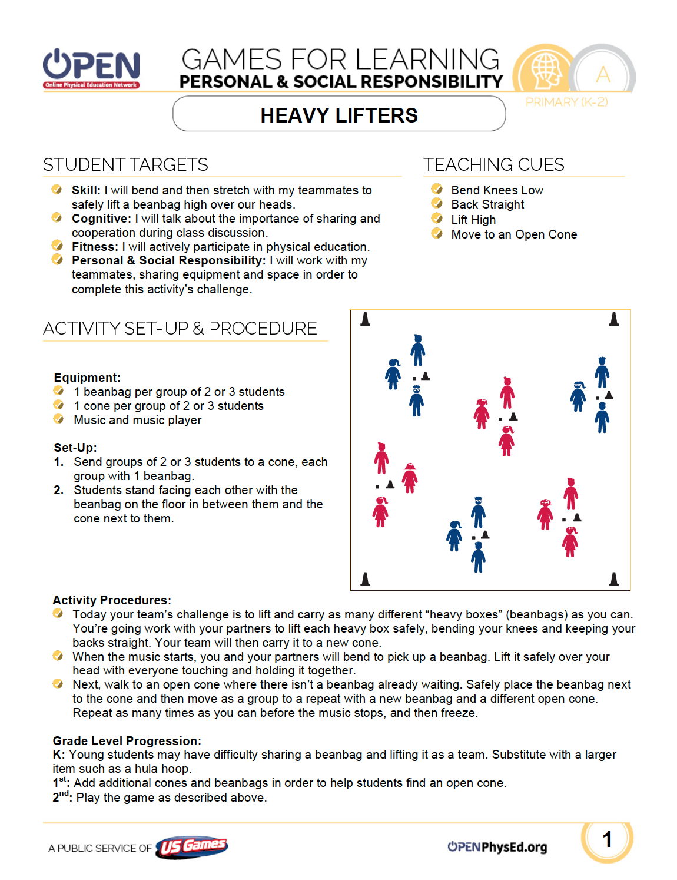
Let’s Experience OPEN’s Academic Language!
Notes:
Time to highlight Academic Language Cards. Have some printed and posted on cones or on the wall. Be sure to tell participants these are in PDF and MS Word – they are fully customizable.
All modules contain 20 to 40 cards specific to the module content area.

Slide 6
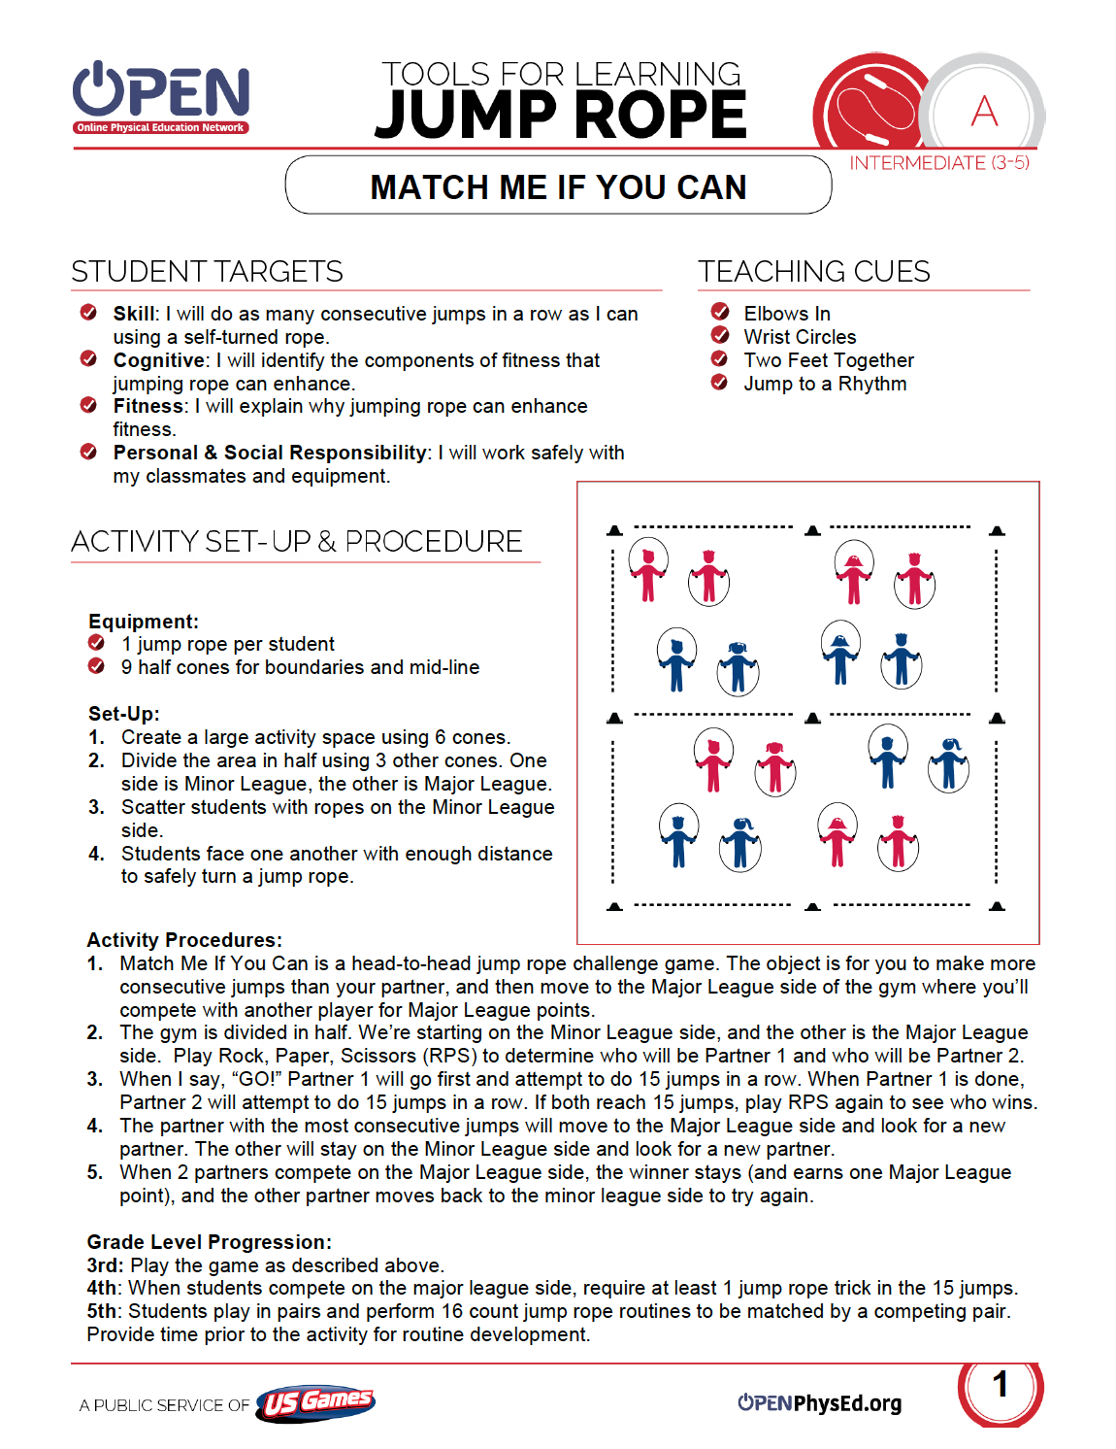
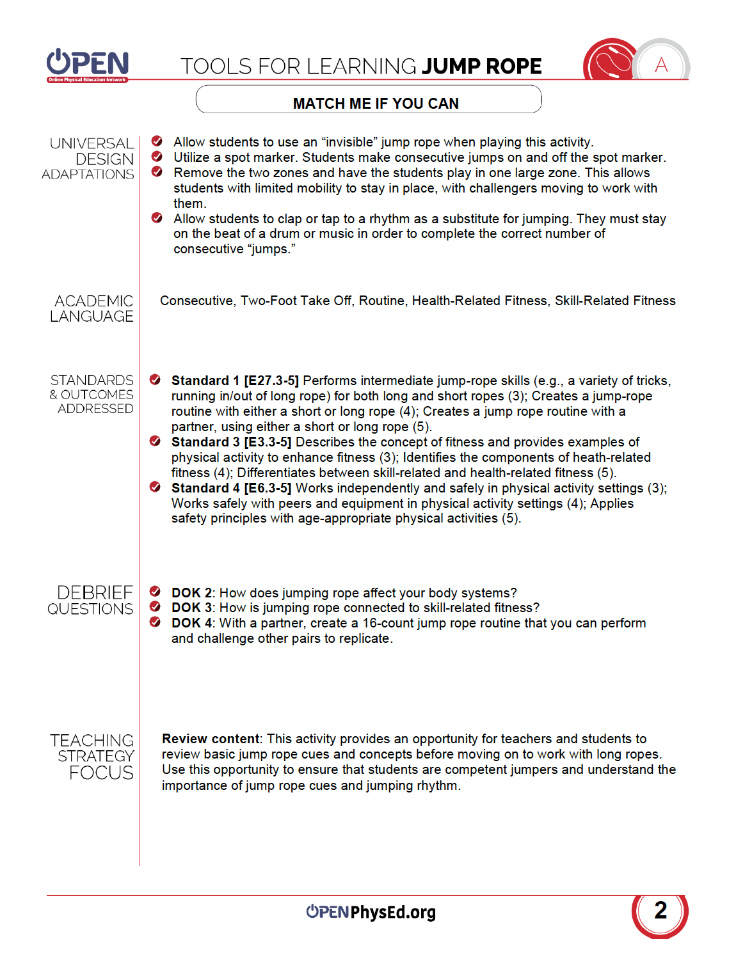
Let’s Experience OPEN’s DOK Questions!
DOK 1: What is skill-related fitness?
DOK 2: Choose one component of skill-related fitness and describe why it’s important in everyday life.
DOK 3: How is jumping rope connected to skill-related fitness? Give specific examples.
Notes:
Play Match Me If You Can, then model a DOK Debrief session using these questions.

Slide 7
What is Depth of Knowledge (DOK)?
DOK categorizes tasks according to the complexity of thinking required to successfully complete them.
There are 4 DOK Levels:
Recall & Reproduction
Skills & Concepts
Strategic Thinking
Extended Thinking
Read more about DOK at the OPEN Blog: http://openphysed.org/?p=83
Notes:
Quickly exlplain each level and reference the blog article.
DOK Extended Explainations:
Level 1 requires students to recite facts or to use simple skills or abilities.
Level 2 includes the engagement of some mental processing beyond recalling or reproducing a response. It requires both comprehension and subsequent processing of information.
Level 3
Deep knowledge becomes more of a focus at Level 3. Students are encouraged to go beyond information and context. However, they are still required to show understanding of the ideas and skills. Students may be encouraged to explain, generalize, connect ideas, or perform skills in a dynamic environment. Task at Level 3 involve reasoning and planning. Students must be able to support their thinking.
Level 4
Higher order thinking is central and knowledge is deep at Level 4. Tasks at this level will probably be an extended activity, with extended time provided. However, the extended time period is not a distinguishing factor. Students take information from at least one content area and are asked to apply this information to a new task. They may also be asked to develop hypotheses and perform complex analyses of the connections among concepts, skills, and settings.

Slide 8
Putting DOK & Academic Language Together
Robotics Lab (3-5 PSR)
DOK 1: How can you recognize safe behaviors?
DOK 2: How would you compare and contrast safe behaviors with dangerous behaviors?
DOK 3: Can you predict what would happen in our Robotics Lab if students acted in ways that were not safe?
Notes:
Utilizing academic language in tiered discussion and increasingly complex learning tasks provides a rigorous environment for students to develop the necessary vocabulary of skills and academic language words and symbols.

Slide 9
Customizable Resources
Passing Challenge Cards
(Middle School Roundnet)
Notes:
All modules include skill card, station cards, assessments and more. Files are almost always delivered in PDF and Word documents making the entire program customizable based on teacher and student needs.

Slide 10
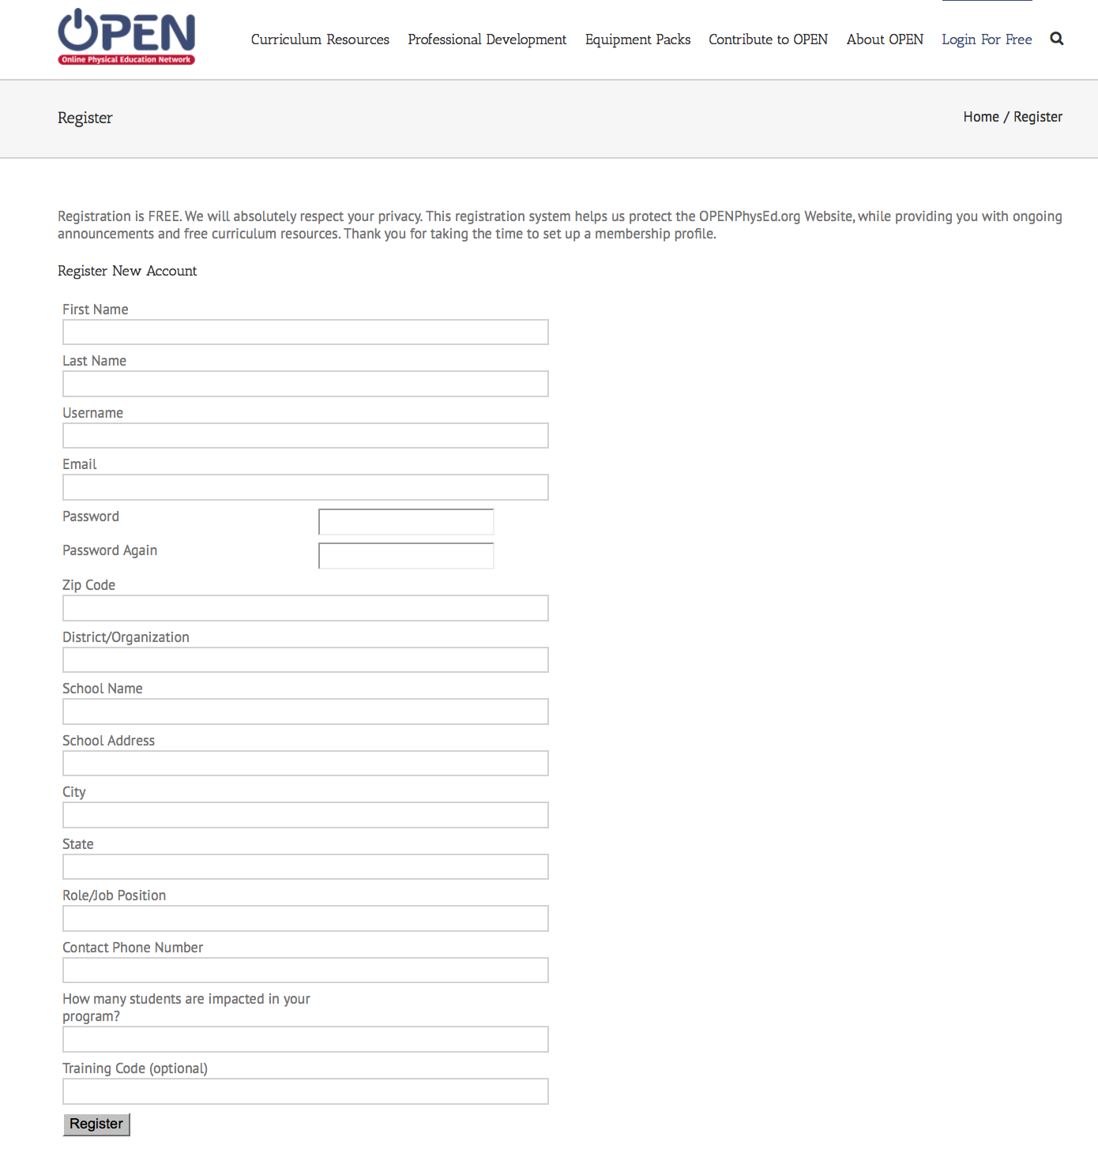
Time to Access OPENPhysEd.org
Step 1: Visit www.OPENPhysEd.org
Step 2: Mouse-over “Login for Free” select “Signup Now”
Step 3: Fill out information, then click the “Register” button (bottom of page)
Step 4: Login using your new username and password
Step 5: Go to “Curriculum Resources” to access all of the OPEN content
Use Training Code: CAHPERDCCC
Notes:
Use your Twitter Handle or Email Address as the training code. This allows the OPEN staff to give you “credit” for each registered user that you support. If an internet connect is available you may want to go to the site and show registration live on the website. If a computer lab is open, it helps to let participants register and then explore the website.
GREAT JOB!

