Slide 1
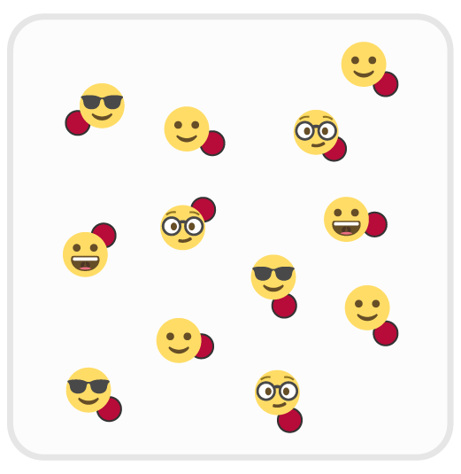
TRAFFIC TIME IN THE GARAGE
LEARNING TARGETS:
Skill: I will move with balance and control.
Cognitive: I will start and stop with the music as my signal.
Physical Activity: I will be active using different locomotor skills.
SEL: I will demonstrate respect through positive behaviors & words.
TARGET VOCABULARY:
Respect, Balance, Control, Start/Stop Signal, Locomotor Skills
EQUIPMENT NEEDED:
1 spot marker per student, Music
ORGANIZE:
Space: Spots are “parking spots” and are scattered in area.
Students: Students start the game standing on a parking spot.
PROCEDURES:
The Object: The object of the game is to move safely in the activity area.
The Process: When the music is on, “drive” around the garage without moving over parking spots. When the music is off, find any empty spot and park on top of the spot. Move on and off spots safely and with respect for self and others.
DEVELOPMENTAL MODIFICATIONS FOR DIFFERENTIATION:
Allow students to move in any appropriate and safe way to match their skill and preference.
Prompt students to perform a different locomotor skills during each new round of movement.
DISCUSSION STARTERS:
What does respect look like in physical education class?
How did you demonstrate respect for self in this activity?
How did you demonstrate respect for others in this activity?

Slide 2
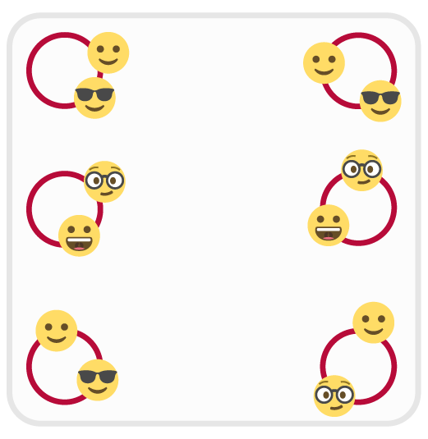
HULA HOOP HIDEOUTS
LEARNING TARGETS:
Skill: I will move mindfully with consideration for other.
Cognitive: I will start and stop with the music as my signal.
Physical Activity: I will be active using different locomotor skills.
SEL: I will demonstrate respect by sharing equipment with classmates.
TARGET VOCABULARY:
Respect, Share, Safe, Start/Stop Signal, Locomotor Skills
EQUIPMENT NEEDED:
12 Hula Hoops, Music
ORGANIZE:
Space: Hoops are “forest hideouts” and are scattered in area.
Students: Students start the game standing with a foot in a hoop.
PROCEDURES:
The Object: When the music stops, quickly hide from Big Foot by standing with 1 foot in a hoop.
The Process: When the music is on, students move through the forest saying hello to their friends. When the music stops, students quickly move to a hoop (sharing) and stand with 1 foot safely inside the hoop. Continue for several rounds of starts/stops.
DEVELOPMENTAL MODIFICATIONS FOR DIFFERENTIATION:
Allow students to place any body part of implement inside of the hoop to be safe.
Play this game with 1 students as Big Foot (a tagger). Students must get to a hoop before being tagged.
DISCUSSION STARTERS:
What is sharing? How does sharing help us have fun with our friends and classmates?
How is sharing related to respect for other? Can you give other examples of sharing that demonstrate respect for others?

Slide 3
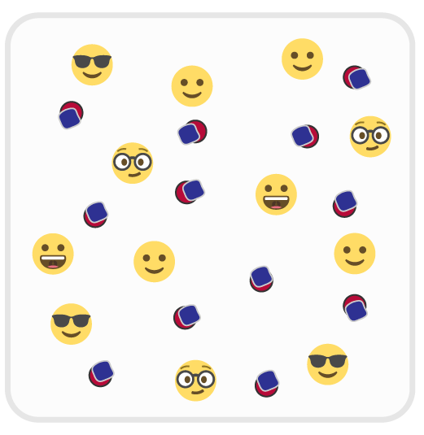
THE FRAGILE MOVING COMPANY
LEARNING TARGETS:
Skill: I will move mindfully with consideration for others.
Cognitive: I will start and stop with the music as my signal.
Physical Activity: I will be active using different locomotor skills.
SEL: I will demonstrate respect for physical education equipment.
TARGET VOCABULARY:
Respect, Equipment, Safe, Balance, Control, Start/Stop Signal
EQUIPMENT NEEDED:
1 bean bag per student; 2 spot markers per student, music
ORGANIZE:
Space: Spots are “safe bubbles” scattered in space. Bean bags are “fragile crystals” placed on top of a spot.
Students: Students start the game scattered in the activity area.
PROCEDURES:
The Object: Work to move as many fragile crystals as you can from one safe bubble to another.
The Process: When the music starts, move to a crystal, pick it up, and gently move it to another bubble. Continue moving as many crystals as you can while the music plays. When the music stops, hold up the total number of crystals moved using your fingers.
DEVELOPMENTAL MODIFICATIONS FOR DIFFERENTIATION:
Allow students to use adaptive equipment that helps them carry the bean bags.
Students work in pairs or small groups to cooperatively move each bean bag.
DISCUSSION STARTERS:
What does it look like when someone is respecting the equipment that we use in physical education?
Why is respecting our equipment important?

Slide 4
BUBBLE JUMPERS
LEARNING TARGETS:
Skill: I will jump and land safely on the bubbles.
Cognitive: I will talk about good health with my classmates
Physical Activity: I will stay physically active for the entire activity.
SEL: I will think about how good health is related to self respect.
TARGET VOCABULARY:
Good Health, Jump, Physical Activity, Self Respect
EQUIPMENT NEEDED:
1 spot marker per student, music
ORGANIZE:
Space: Spots are bubbles and are scattered in general space.
Students: Students start the game scattered in the activity area.
PROCEDURES:
The Object: Jump and land on as many bubbles as you can while the music is playing.
The Process: When the music starts, move to a bubble (spot). Jump and land on the bubble with 2 feet. When you land, say, “POP!” Then, quickly and safely move to the next bubble and repeat. When the music stops, hold up the total number of bubbles popped using your fingers.
DEVELOPMENTAL MODIFICATIONS FOR DIFFERENTIATION:
Allow students to “pop” the bubbles using a variety of movements (other than jumping), based on still/ability.
Provide students with a ball to dribble (hand or foot). Students “pop” bubbles by dribbling over each spot.
DISCUSSION STARTERS:
What is good health? What does it look like to have good health? What does it feel like?
What do you know about helping your body have good health?
How is regular physical activity related to good health? How is that related to self respect?

Slide 5
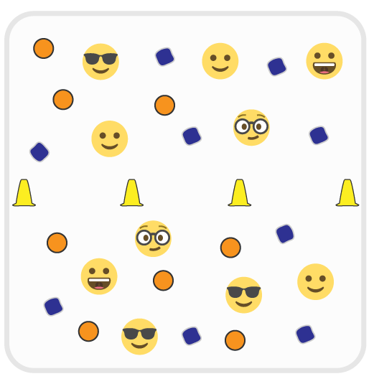
SHARE-A-LOT
LEARNING TARGETS:
Skill: I will safely demonstrate a variety of ways to move my body.
Cognitive: I will talk about sharing in physical education class.
Physical Activity: I will share as many objects as I can..
SEL: I will use positive words to talk with teachers and classmates.
TARGET VOCABULARY:
Locomotor Skills, Positive, Respect, Share, Start/Stop Signal
EQUIPMENT NEEDED:
2-6 cones for centerline, 1 foam ball or bean bag per student, music
ORGANIZE:
Space: Use cones to create a centerline in the activity area. Scatter balls/bean bags evenly on each side of the activity area.
Students: Create 2 teams - 1 team on each side of the line.
PROCEDURES:
The Object: Share as many objects as you can with the other team while the music is playing.
The Process: When the music starts, pick up a bean bag or foam ball and carry it to the other side of the line. Set it down in an open space and say, “I LOVE TO SHARE!” Then return to your side, collect a new object and share again. When the music stops, freeze and wait for more instructions. Listen as I call out different locomotor skills for you to use as we share. Let’s start at a walking pace.
DEVELOPMENTAL MODIFICATIONS FOR DIFFERENTIATION:
Provide a variety of safe objects based on student preference and ability.
Use spots markers or hoops to designate spots where you want equipment placed.
DISCUSSION STARTERS:
What would you put on a list about sharing equipment? What are all the things we know about sharing in PE?
What are some respectful and positive words that we can use to ask someone to share with us?

Slide 6
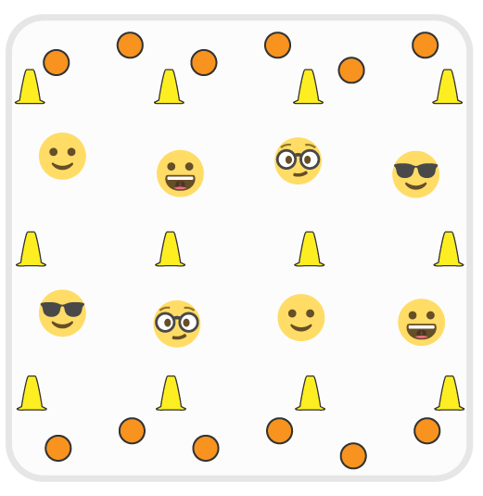
TOUCHDOWN TRADERS
LEARNING TARGETS:
Skill: I will safely demonstrate a variety of ways to move my body.
Cognitive: I will talk about sharing in physical education class.
Physical Activity: I will share as many objects as I can..
SEL: I will use positive words to talk with teachers and classmates.
TARGET VOCABULARY:
Locomotor Skills, Positive, Respect, Share, Start/Stop Signal
EQUIPMENT NEEDED:
6-12 cones field markings, 1 foam ball per student, music
ORGANIZE:
Space: Use cones to create a centerline and 2 endzones on opposite ends of the activity area. Scatter foam balls evenly in each end zone.
Students: Create 2 teams - 1 team on each side of the line.
PROCEDURES:
The Object: Score as many touchdowns as you can by running a ball into the opposite end zone.
The Process: When the music starts, pick up a foam ball from your end zone and move safely though the activity area into the opposite end zone. When you score a touchdown, place the ball carefully on the floor of the end zone and then return to your team’s endzone to collect a new ball and repeat. When the music stops, freeze and listen for new instructions. We’ll start at a walking pace.
DEVELOPMENTAL MODIFICATIONS FOR DIFFERENTIATION:
Use cones and directional arrows to help students understand where to move.
Skilled classes may be ready to work in pairs and pass the ball from partner to partner toward the end zone..
DISCUSSION STARTERS:
How did you show respect for our equipment during this game of Touchdown Traders?
What other games have you played in physical education or at recess that gave you an opportunity to show respect for equipment?

Slide 7
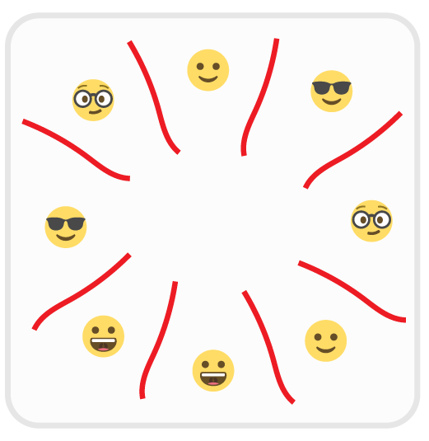
JUMP ROPE HURDLE HUSTLE
LEARNING TARGETS:
Skill: I will safely move over each jump rope.
Cognitive: I will move in clockwise and counterclockwise directions.
Physical Activity: I will stay physically active while the music plays.
SEL: I will demonstrate self-respect by practicing and improving my movement skills.
TARGET VOCABULARY:
Locomotor Skills, Practice, Improve, Self-Respect
EQUIPMENT NEEDED:
1 jump rope per student (can use spot markers or low cones), music
ORGANIZE:
Space: Lay ropes on the floor with each rope shaped like a line. Create a circle of rope lines (like the face of a clock) with enough space for students to move safely in between the ropes.
Students: Send students to stand at a rope (1 per student).
PROCEDURES:
The Object: To leap over each rope while moving clockwise and counterclockwise around the area.
The Process: When the music starts, walk clockwise around the activity area. As you get to a rope, step over it and continue. When the music stops, freeze and listen. Next, leap over each rope as you get to it. Start at a slow jogging pace. When the music stops, freeze and listen. Next, we’ll move in a counterclockwise direction.
DEVELOPMENTAL MODIFICATIONS FOR DIFFERENTIATION:
Use cones and directional arrows to help students understand which direction to move in.
Prompt students to use different locomotor skills to move around the activity area.
DISCUSSION STARTERS:
What does practice mean? What do you know about practice?
What is self-respect? How is improving your skill related to self-respect?

Slide 8
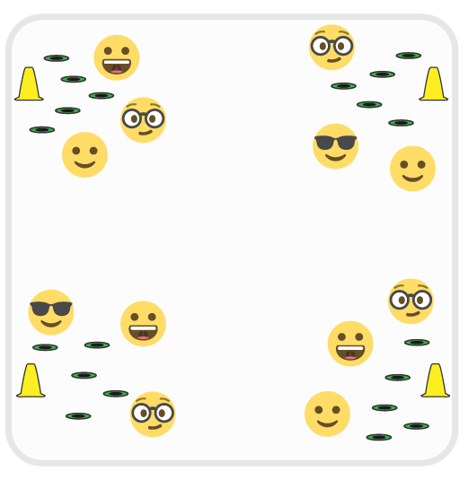
CORNER-TO-CORNER
LEARNING TARGETS:
Skill: I will safely move from corner-to-corner.
Cognitive: I will help my class create a list of respectful words.
Physical Activity: I will stay physically active while the music plays.
SEL: I will demonstrate respect for my classmates while I flip cones.
TARGET VOCABULARY:
Clockwise, Counterclockwise, Locomotor Skills, Respect
EQUIPMENT NEEDED:
4 large cones, 1 low-profile cone per student, music
ORGANIZE:
Space: Create a large activity area with cones in each corner. Divide low-cones into 4 sets. Scatter each set in the 4 corners around the large cones.
Students: Send students to stand at a low profile cone.
PROCEDURES:
The Object: To move from corner-to-corner, flipping a low-profile cone every time reach a corner.
The Process: When the music starts, walk clockwise to the next corner. As you get to a corner, find a low-profile cone and flip it over. If it’s already been flipped, then flip it back. Be respectful to your classmates who are also working to flip cones. When the music stops, freeze and listen for more instructions.
DEVELOPMENTAL MODIFICATIONS FOR DIFFERENTIATION:
Directional arrows to help students understand which direction to move in.
Prompt students to use different locomotor skills, speeds, and levels while moving from corner-to-corner.
DISCUSSION STARTERS:
How can you show respect to others during this game of Corner-To-Corner?
What words would you put on a list of respectful things to say to a classmate?

Slide 9
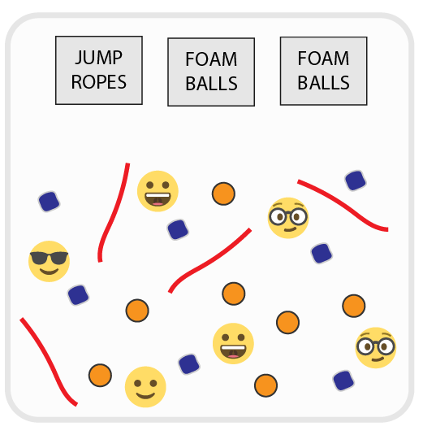
THE CALM CLEANER
LEARNING TARGETS:
Skill: I will safely move from corner-to-corner.
Cognitive: I will help my class make a list of respectful words.
Physical Activity: I will enjoy today’s physical activity.
SEL: I will demonstrate respect for my classmates as we clip cones.
TARGET VOCABULARY:
Locomotor Skills, Practice, Improve, Self-Respect
EQUIPMENT NEEDED:
Music and a lot of bean bags, low-profile cones, foam balls, jump ropes, and equipment station signs
ORGANIZE:
Space: Scatter the equipment randomly around the activity area. Create an equipment station for all of the types of equipment used.
Students: Send students to stand next to any piece of equipment.
PROCEDURES:
The Object: To calmly clean up the equipment by placing it in the correct equipment station.
The Process: When the music starts, move throughout the activity area without touching any equipment. When the music stops, calmly, quickly, and safely collect 1 piece of equipment and return it to the correct equipment stations. When the music starts again, move throughout the activity area. Repeat as the music starts and stops.
DEVELOPMENTAL MODIFICATIONS FOR DIFFERENTIATION:
Allow students to work in pairs. Match students who can support one another..
Prompt students to use different locomotor skills, speeds, and levels while moving throughout the area..
DISCUSSION STARTERS:
What are different ways that we can help take care of the physical education equipment?
Are there other times and places that you could practice being helpful and help someone clean up?

