Slide 1
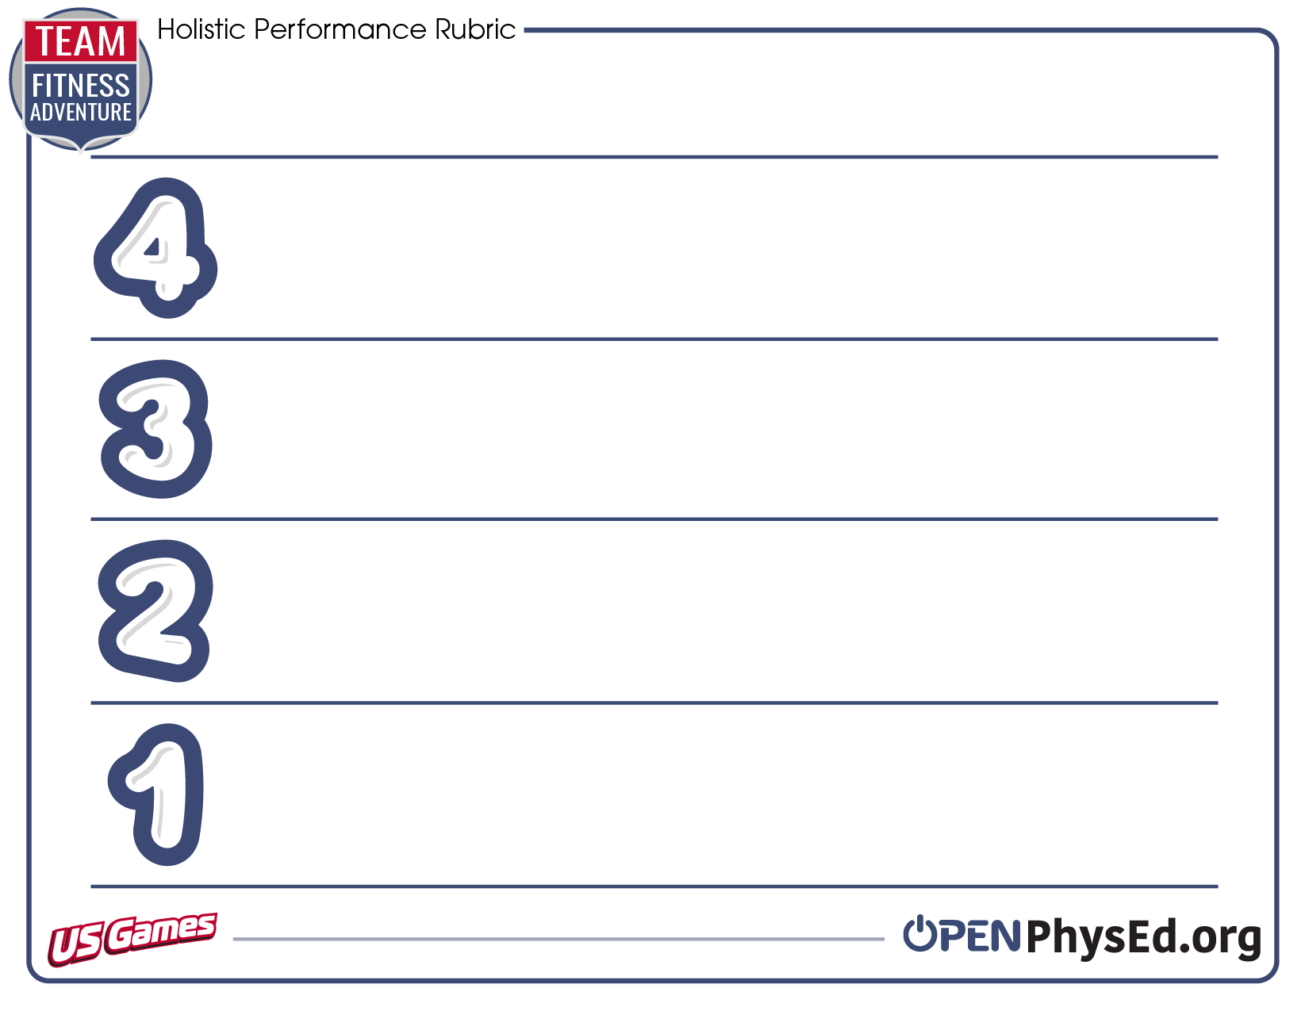
Score a perfect four! Read about what you need to do and then make it happen.
Every time I come to physical education class, I treat my teacher and my classmates with respect. I follow all directions and help everyone stay safe.
I move with control and balance and I respect all physical education equipment. I can define the components of health-related fitness.
When I come to physical education class, I treat my teacher and my classmates with respect. I follow all directions with only 1 or 2 reminders, and help everyone stay safe. I move with control and I respect all physical education equipment.
I can define the components of health-related fitness.
When I come to physical education class, I work to treat others with respect. I still need reminders that help me follow directions, but I’m getting better each class. I move safely but sometimes lose control. I respect physical education equipment. I can talk about what health-related fitness is.
When I come to physical education class, I need reminders on how to show respect to myself and others. I need a lot of reminders that help me follow directions. Sometimes I forget to respect physical education equipment. I don’t really know what health-related fitness is.

