Slide 1
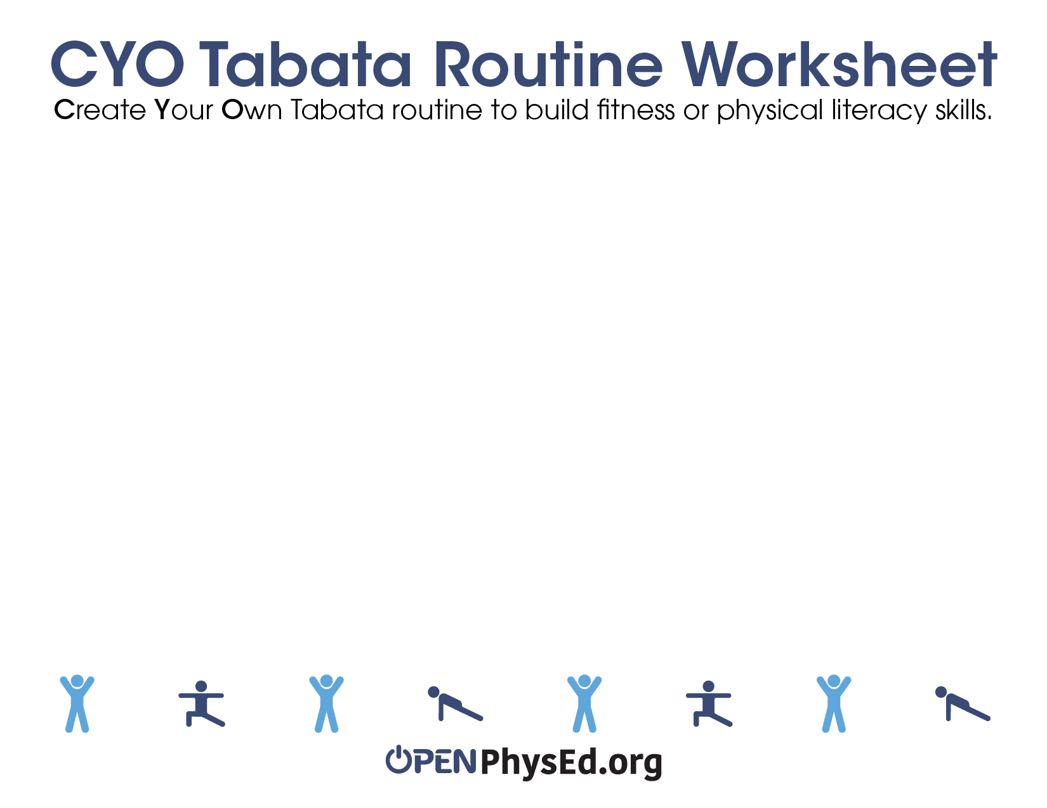
Student Name:
Date:
Follow the rubric criteria on page 2 to create a routine that scores a perfect 3 out of 3.
Exercise Name | Description | Health-Related Fitness Component | Safety Considerations | Overall Health Benefit(s)

Slide 2
Use the rubric criteria below to create a routine on page 1 that scores a perfect 3 out of 3.
 | Routine is Amazing! (3) | Routine is Good to Go (2) | Needs More Work (1)
Safety & Appropriateness | Exercises are appropriate and safe. Leaders can demonstrate exercises with safety cues. | Exercises are appropriate and safe. | Exercises are not appropriate and could be unsafe.
Fitness Concepts | Exercises are in the correct health-related fitness category. | Exercises are place in the correct category with some help. | Exercises are not in the correct category.
Health Benefits | Routine works in a target heart rate zone. Student can explain 3 health benefits of the routine. | Route works in a target heart rate zone. Student can explain 1 health benefit of the routine. | Routine does not provide the intensity needed to reach a target heart rate zone.

