Slide 1
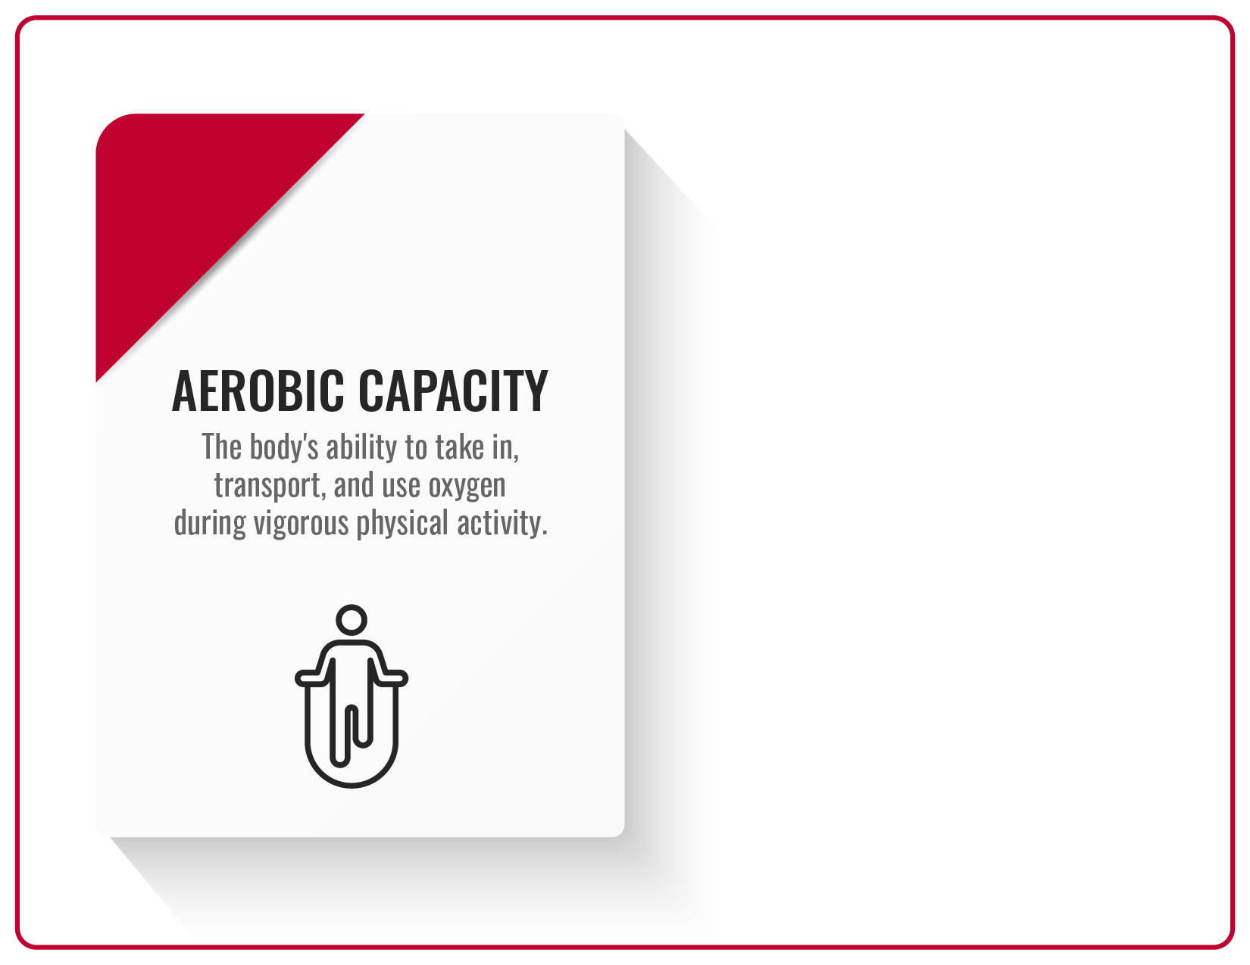

Take Home Tabata Routine
Round 1: Jumping Jacks (20 Sec)
Rest for 10 Seconds
Round 2: Jump Rope (20 Sec)
Rest for 10 Seconds
Round 3: Mummy Jacks (20 Sec)
Rest for 10 Seconds
Round 4: Jump Rope (20 Sec)
Rest for 10 Seconds
Round 5: Jumping Jacks (20 Sec)
Rest for 10 Seconds
Round 6: Jump Rope (20 Sec)
Rest for 10 Seconds
Round 7: Mummy Jacks (20 Sec)
Rest for 10 Seconds
Round 8: Jump Rope (20 Sec)
Rest for 10 Seconds

Slide 2
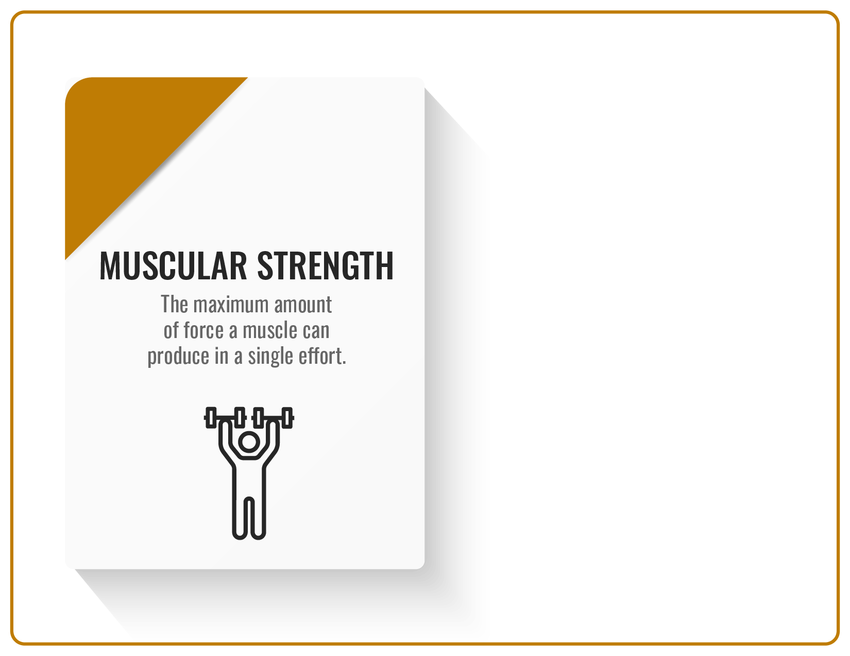
Take Home Tabata Routine
Round 1: SlowMo Push Ups (20 Sec)
Rest for 10 Seconds
Round 2: SlowMo Squats (20 Sec)
Rest for 10 Seconds
Round 3: Power Push Ups (20 Sec)
Rest for 10 Seconds
Round 4: Power Squats (20 Sec)
Rest for 10 Seconds
Round 5: SlowMo Push Ups (20 Sec)
Rest for 10 Seconds
Round 6: SlowMo Squats (20 Sec)
Rest for 10 Seconds
Round 7: Power Push Ups (20 Sec)
Rest for 10 Seconds
Round 8: Power Squats (20 Sec)
Rest for 10 Seconds

Slide 3
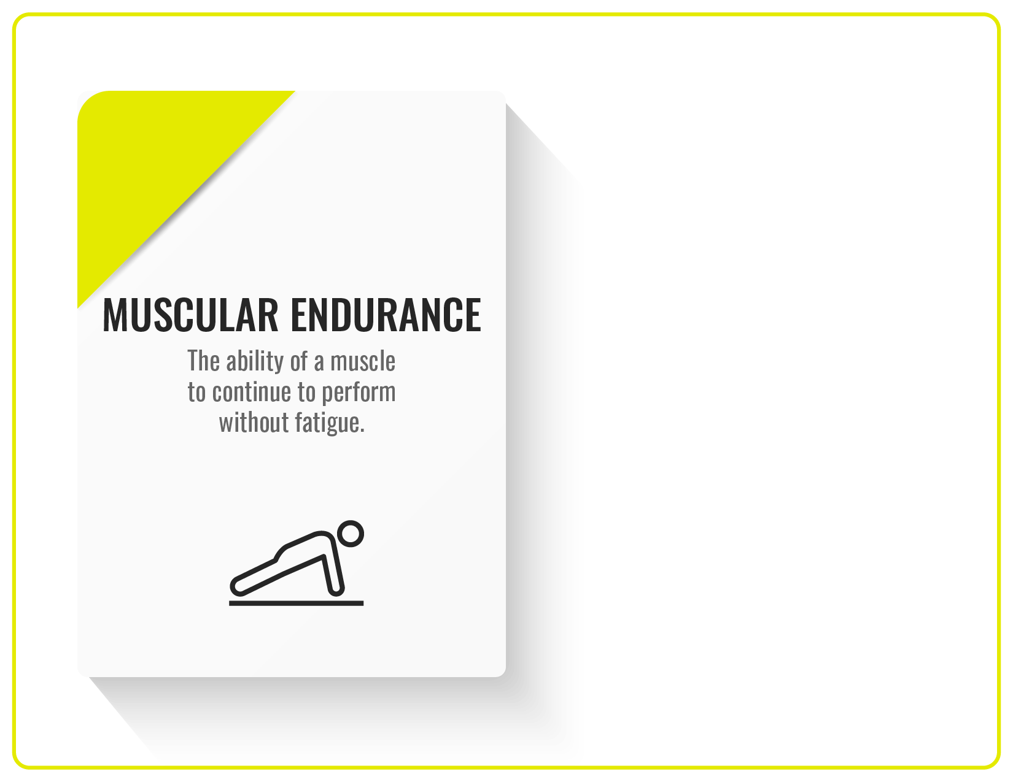
Take Home Tabata Routine
Round 1: Plank Jacks (20 Sec)
Rest for 10 Seconds
Round 2: Plank Arm Lifts (20 Sec)
Rest for 10 Seconds
Round 3: Plank Holds (20 Sec)
Rest for 10 Seconds
Round 4: Planks Leg Lifts (20 Sec)
Rest for 10 Seconds
Round 5: Plank Jacks (20 Sec)
Rest for 10 Seconds
Round 6: Plank Arm Lifts (20 Sec)
Rest for 10 Seconds
Round 7: Plank Holds (20 Sec)
Rest for 10 Seconds
Round 8: Plank Leg Lifts (20 Sec)
Rest for 10 Seconds

Slide 4
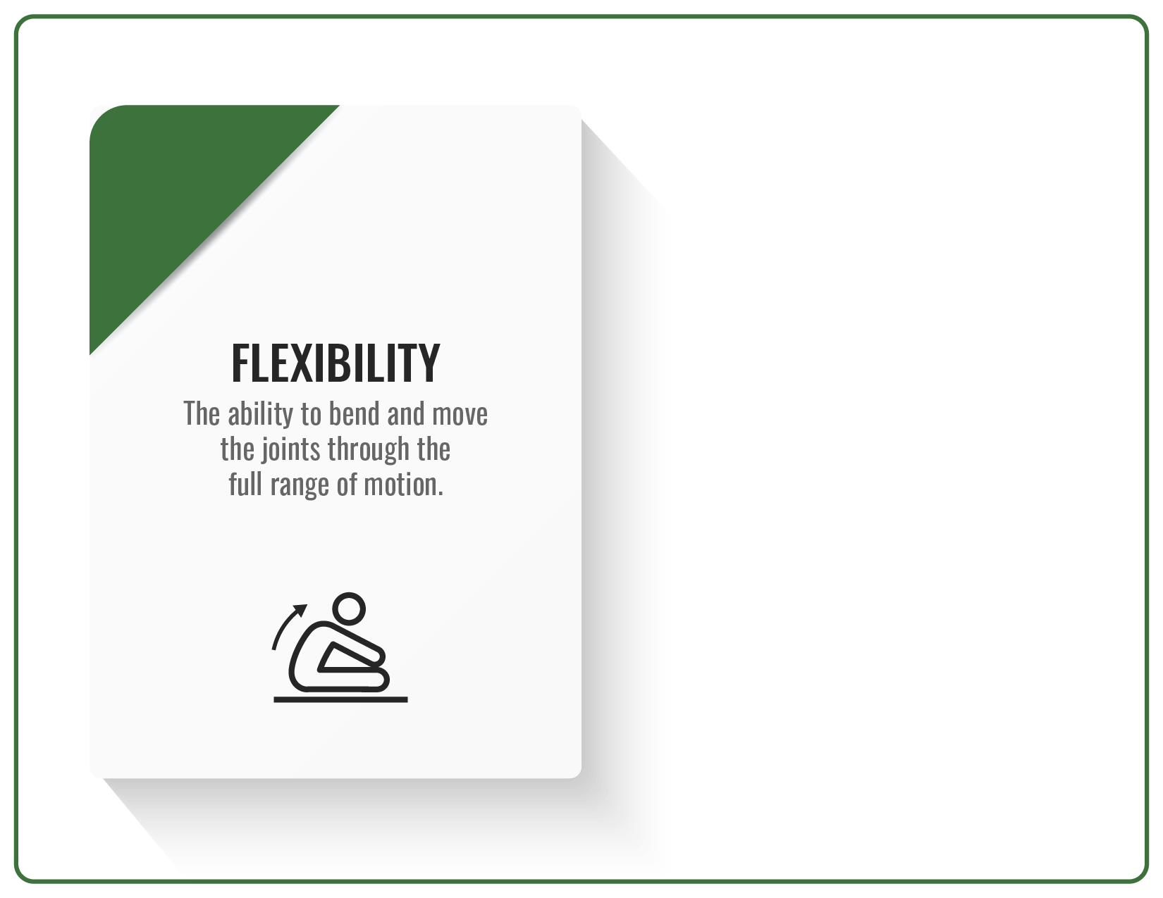
Take Home Tabata Routine
Round 1: Downward Dog (20 Sec)
Rest for 10 Seconds
Round 2: Mountain Pose (20 Sec)
Rest for 10 Seconds
Round 3: Triangle Pose R (20 Sec)
Rest for 10 Seconds
Round 4: Forward Fold (20 Sec)
Rest for 10 Seconds
Round 5: Downward Dog (20 Sec)
Rest for 10 Seconds
Round 6: Mountain Pose (20 Sec)
Rest for 10 Seconds
Round 7: Triangle Pose L (20 Sec)
Rest for 10 Seconds
Round 8: Forward Fold (20 Sec)
Rest for 10 Seconds

Slide 5
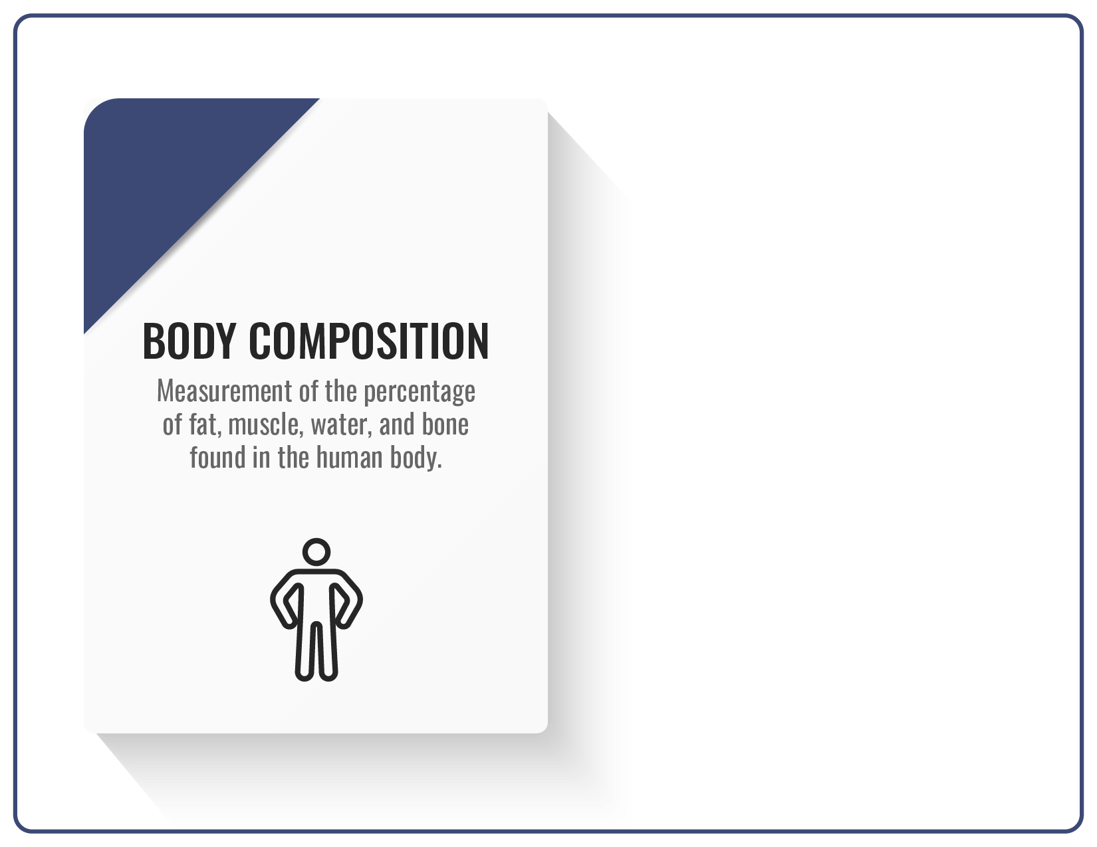
Take Home Tabata Routine
Round 1: Jumping Jacks (20 Sec)
Rest for 10 Seconds
Round 2: SlowMo Push Ups (20 Sec)
Rest for 10 Seconds
Round 3: Plank Jacks (20 Sec)
Rest for 10 Seconds
Round 4: Downward Dog (20 Sec)
Rest for 10 Seconds
Round 5: Jump Rope (20 Sec)
Rest for 10 Seconds
Round 6: SlowMo Squats (20 Sec)
Rest for 10 Seconds
Round 7: Plank Arm Lifts (20 Sec)
Rest for 10 Seconds
Round 8: Forward Fold (20 Sec)
Rest for 10 Seconds

